Slide 1







CouchPotato.
AN E-COMMERCE PLATFORM TO SELL FURNITURE.
Reneeka Nadkarni (C034)
Amishi Desai (C044)
Chahel Gupta (C049)

Slide 2


PROJECT MANAGEMENT TIMELINE
Choosing an E-commerce platform to create
Local server hosting
Add a shopping cart
Performing SWOT analysis
Form Validation
Identify features and design a webpage
Database Connections
Implementing filters
Add a feedback system

Slide 3




WHY DID WE CHOOSE THIS TOPIC?
We understand emerging lifestyle trends and their influence on products of daily use, especially in the setting we live in. Acting as a ‘finger on the design pulse’, we wanted a website to showcase what is new and cutting edge and then translate it into persuasive products and inspiration for the buyer audience. We chose a furniture website catalogue that ranges from eclectic designs produced in India, so as to seamlessly blend a buyer's identity into their homes.

Slide 4

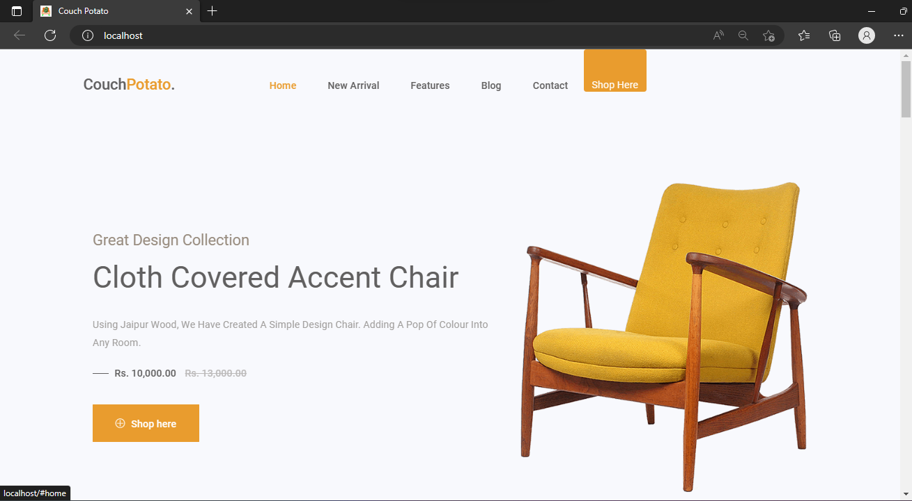
HOME PAGE
Our home page features a preview of some of our latest products, so you can see what's new and trending.
PRICE :

Slide 5
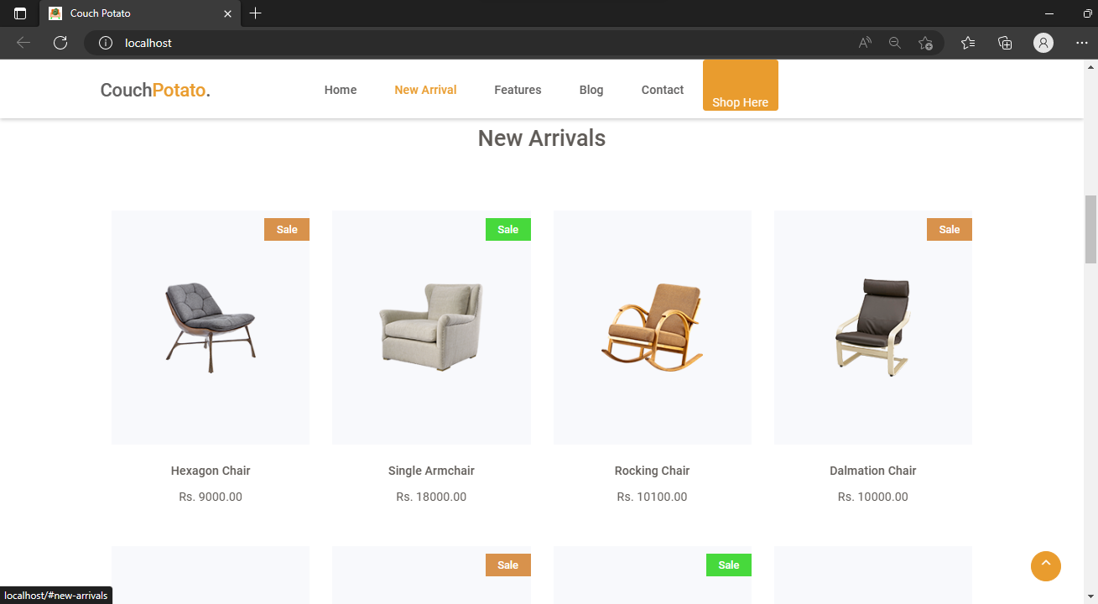
HOME PAGE
NEW ARRIVALS
Check out our "New Arrival" tab to see more. When you're ready to start shopping, simply click on the "Shop Here" to browse our products, which can be added to your cart.
PRICE :

Slide 6
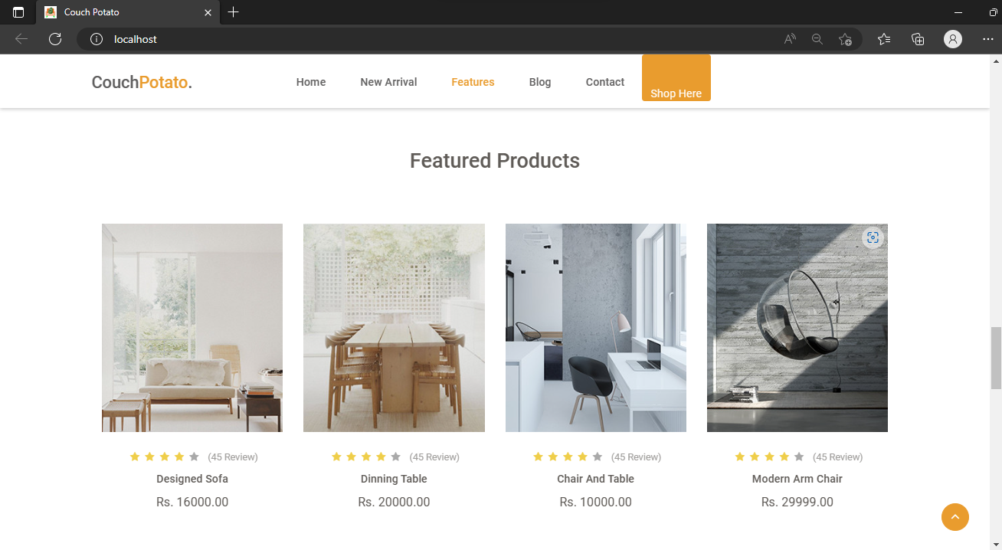
HOME PAGE
FEATURED PRODUCTS
The "Featured Products" section, showcases some popular items.
PRICE :

Slide 7
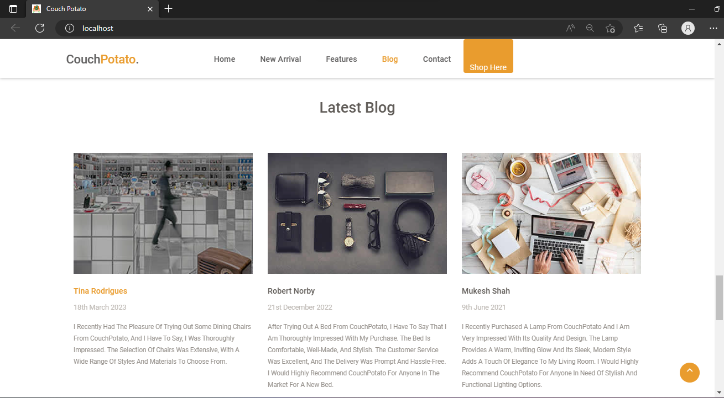
HOME PAGE
LATEST BLOG
If you're looking for inspiration, check out the blog sections for tips and tricks to decorate your home.
PRICE :

Slide 8
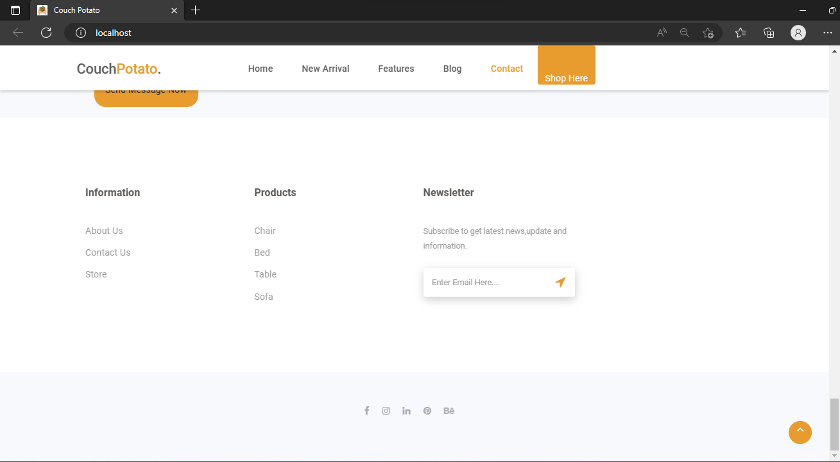
HOME PAGE
CONTACT US
Need to get in touch with us? The contact form makes it easy to send a message with any questions or concerns.
PRICE :

Slide 9
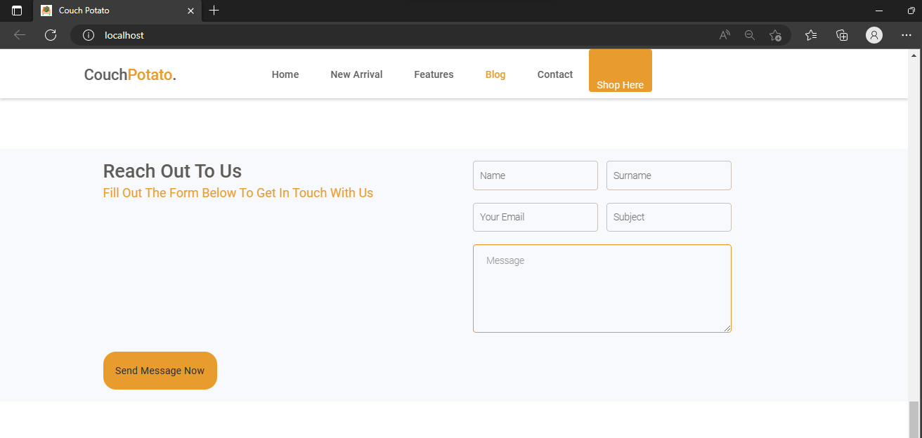
FORM VALIDATION
CONTACT US

Slide 10
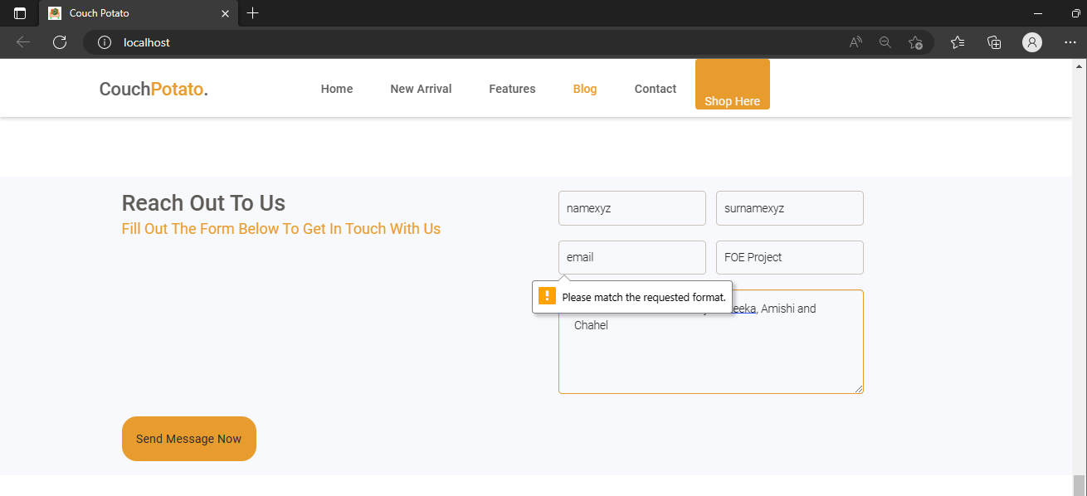
FORM VALIDATION
CONTACT US

Slide 11
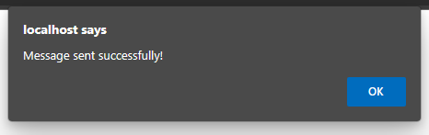
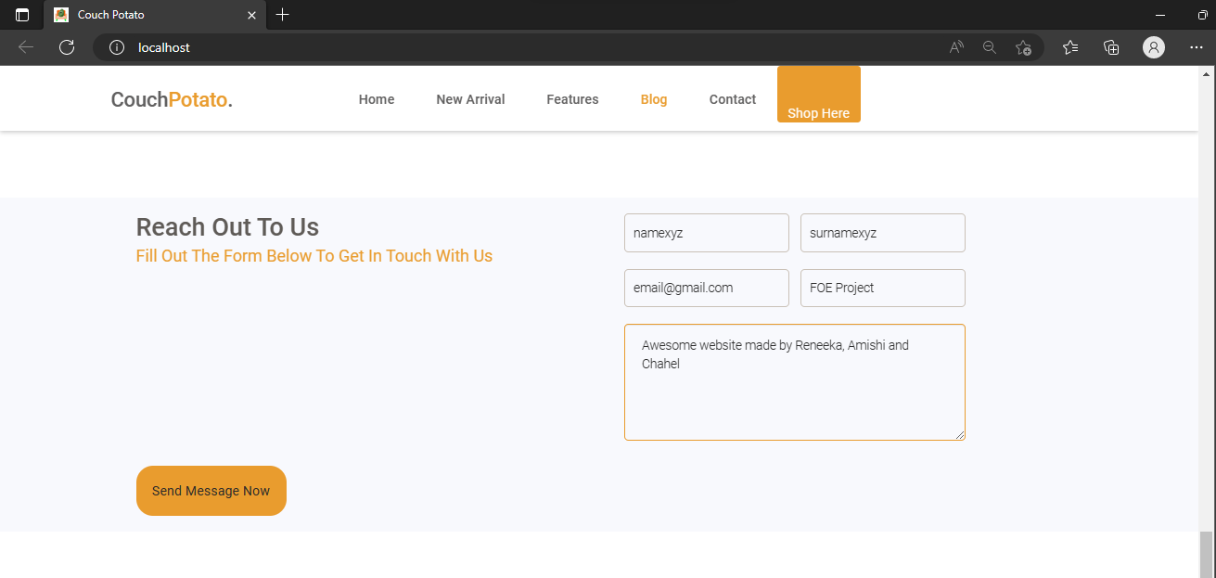
FORM VALIDATION
CONTACT US

Slide 12
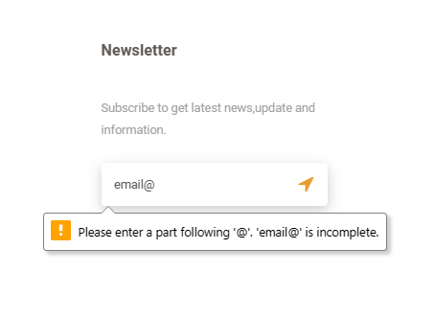
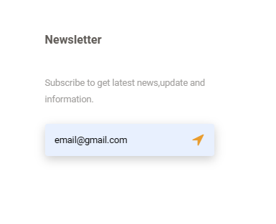
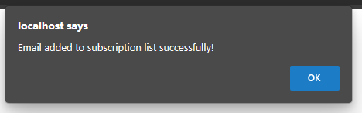
FORM VALIDATION
EMAIL SUBSCRIPTION
WITHOUT CORRECT EMAIL ID
WITH CORRECT EMAIL ID

Slide 13
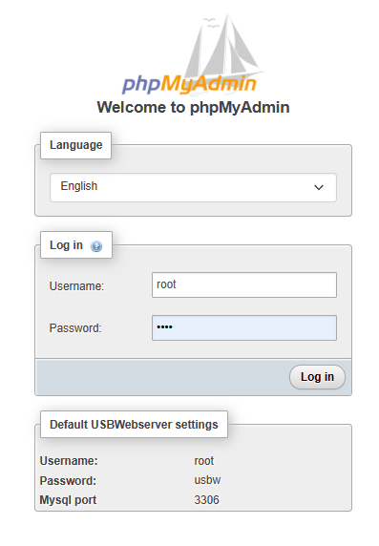
DATABASE MANAGEMENT
SYSTEM
PHPMYADMIN
SQL

Slide 14
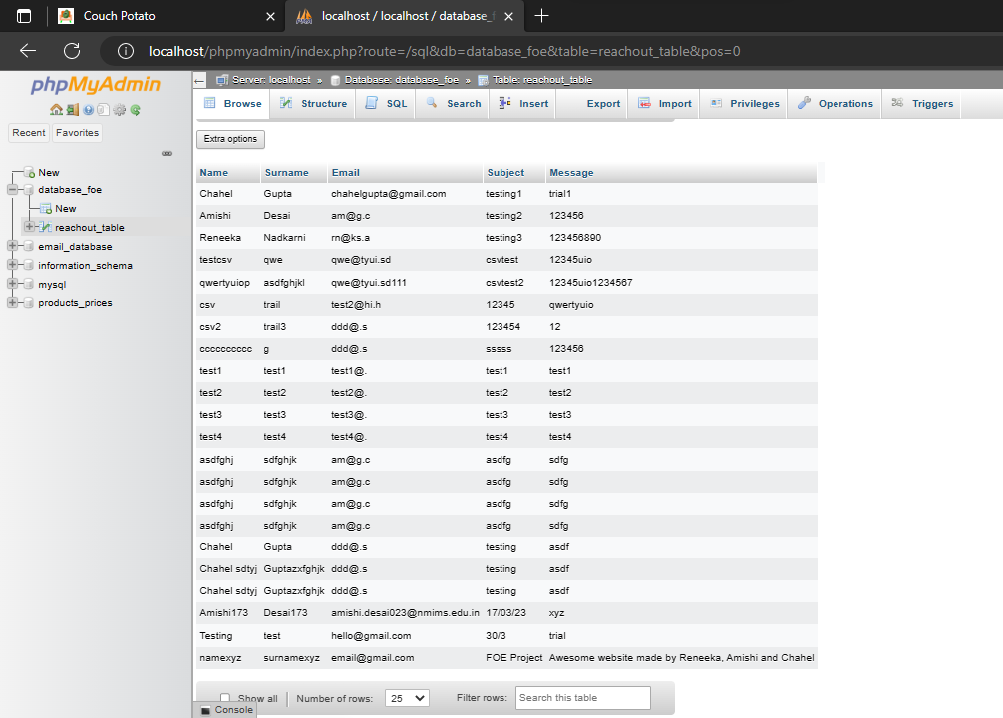
DATABASE MANAGEMENT SYSTEM

Slide 15
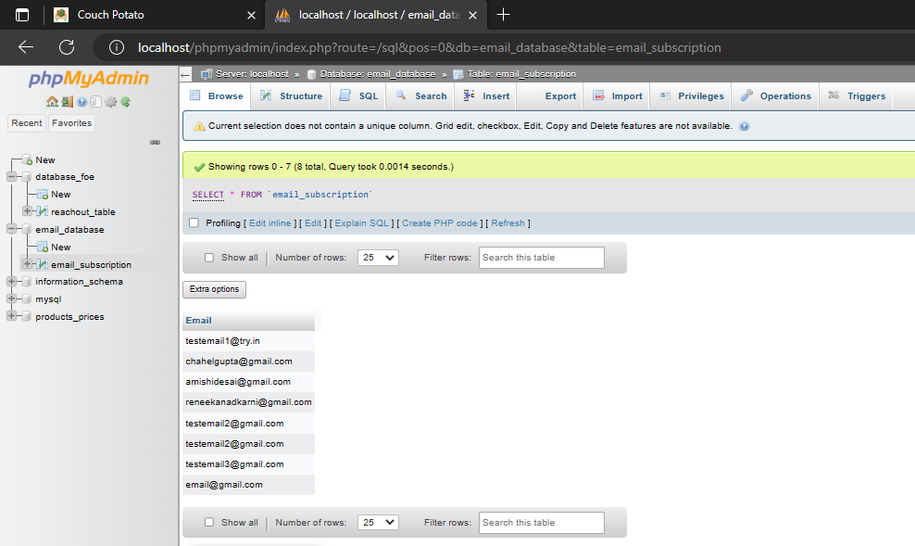
DATABASE MANAGEMENT SYSTEM

Slide 16

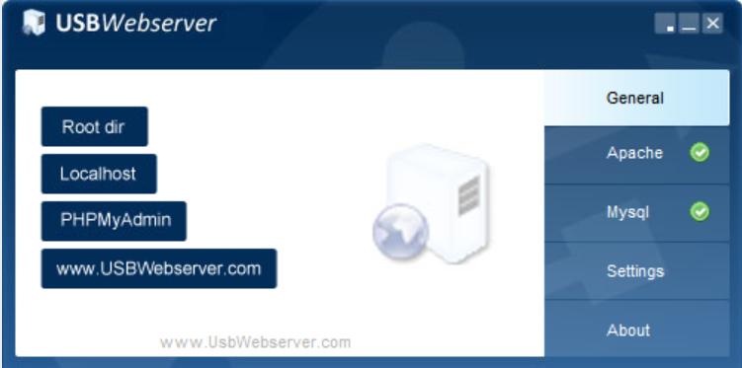
LOCAL SERVER HOSTING
USBWebserver v10
We have used USBWebserver v10 to locally host our website. It is a portable web server software that allows users to run PHP and Apache on Windows operating systems. One of the main benefits of USBWebserver is its portability. Users can run it directly from a USB drive, without having to install any software on their computer.

Slide 17
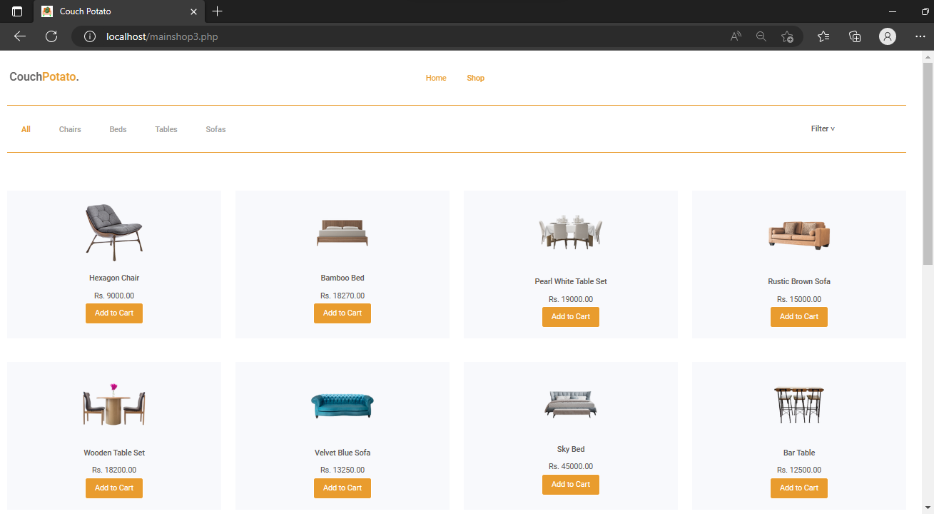

SHOPPING PAGE
WHEN CLICKED

Slide 18
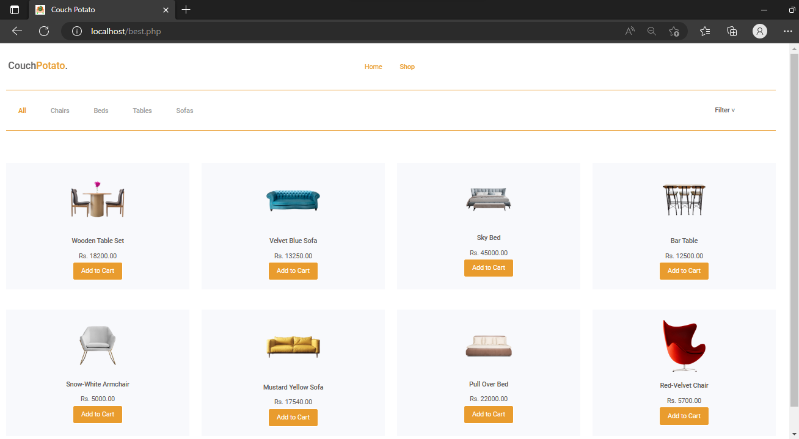
IMPLEMENTING FILTERS
BESTSELLERS

Slide 19
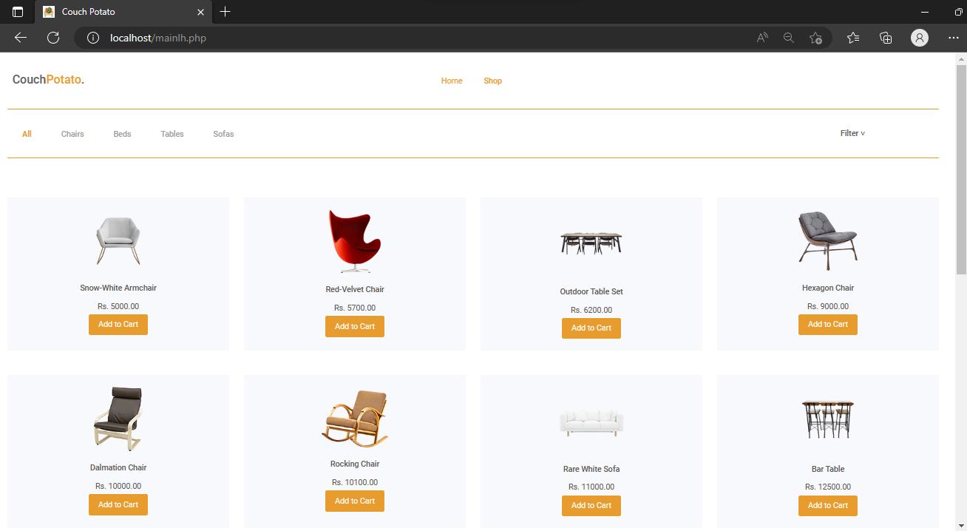
IMPLEMENTING FILTERS
PRICE: LOW TO HIGH

Slide 20
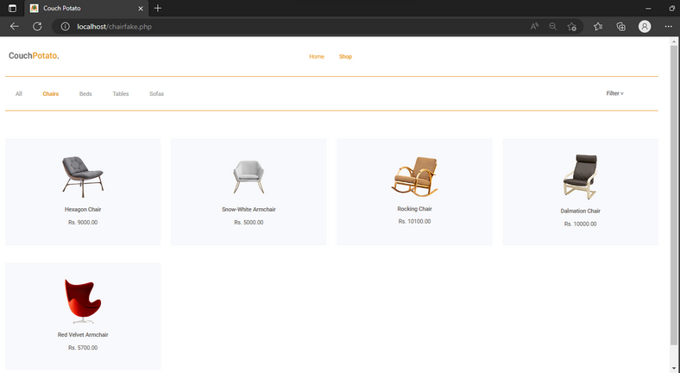
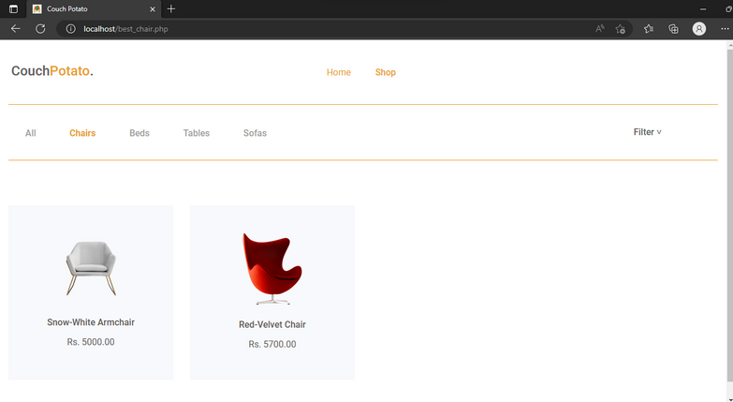
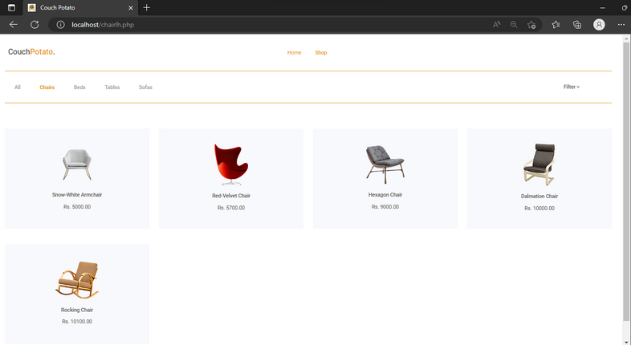
IMPLEMENTING FILTERS
ACCORDING TO PRODUCT
DEFAULT
BESTSELLERS
PRICE: LOW TO HIGH

Slide 21
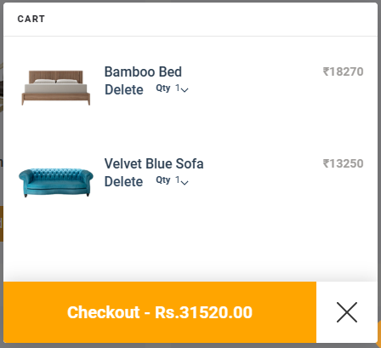
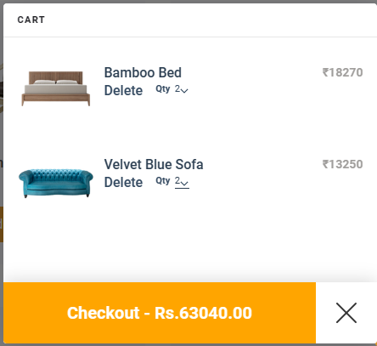
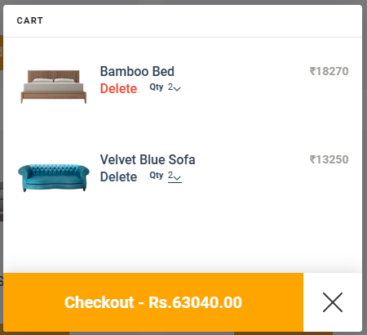
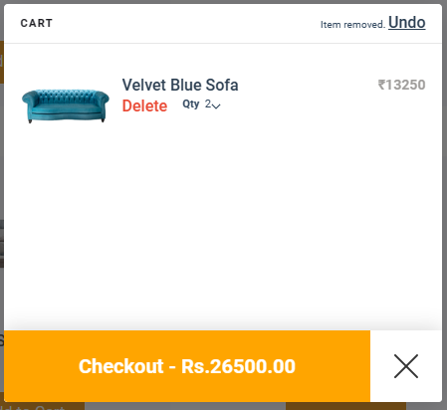
FEATURED
SHOPPING CART
Our "Add to Cart" feature is designed to make the online shopping process as simple and convenient as possible, so you can focus on finding the perfect furniture for your home without any hassle. When you find a product you want to buy, simply click the "Add to Cart" button to add it to your virtual shopping cart. The cart feature also lets you view the total cost and lets you make any adjustments before you complete your purchase.

Slide 22
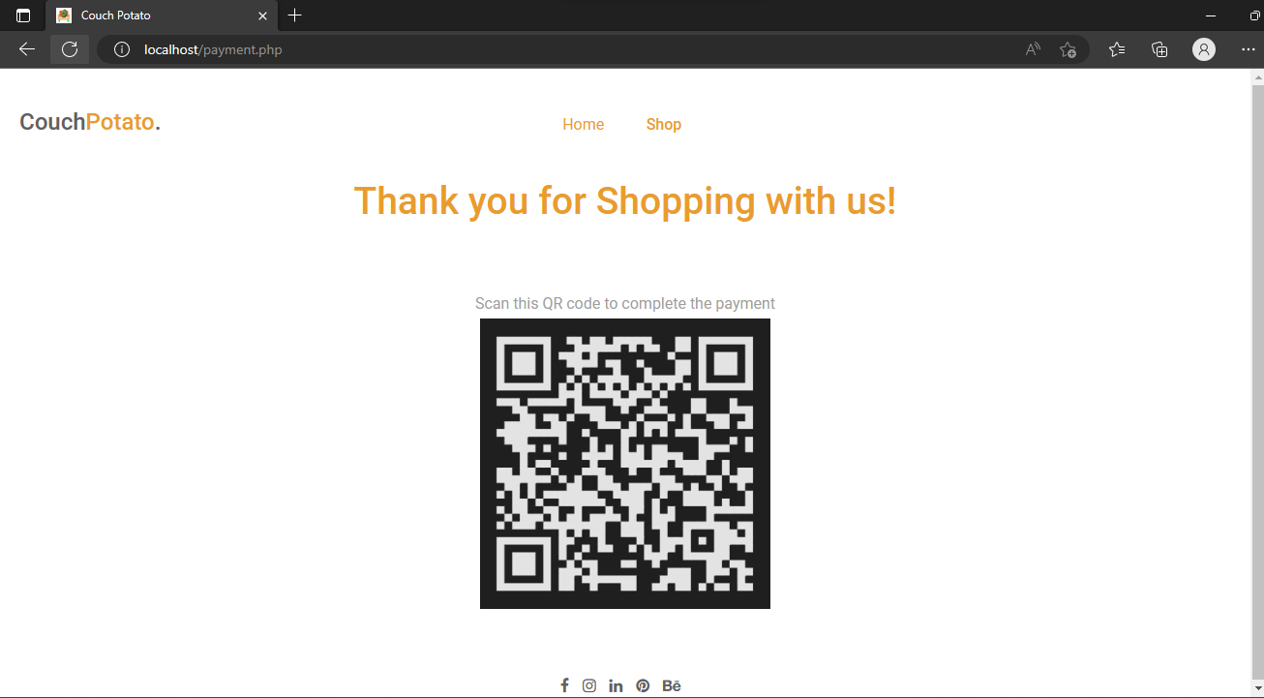
CHECKOUT PAGE

Slide 23
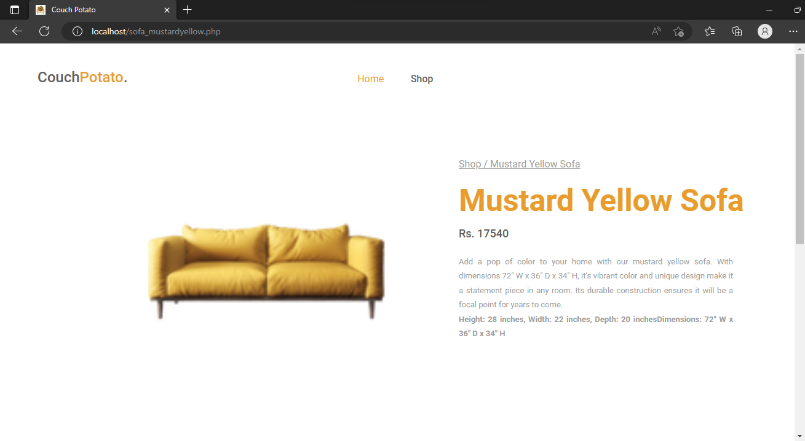

FEEDBACK SYSTEM
CUSTOMER REVIEWS & RATINGS

Slide 24
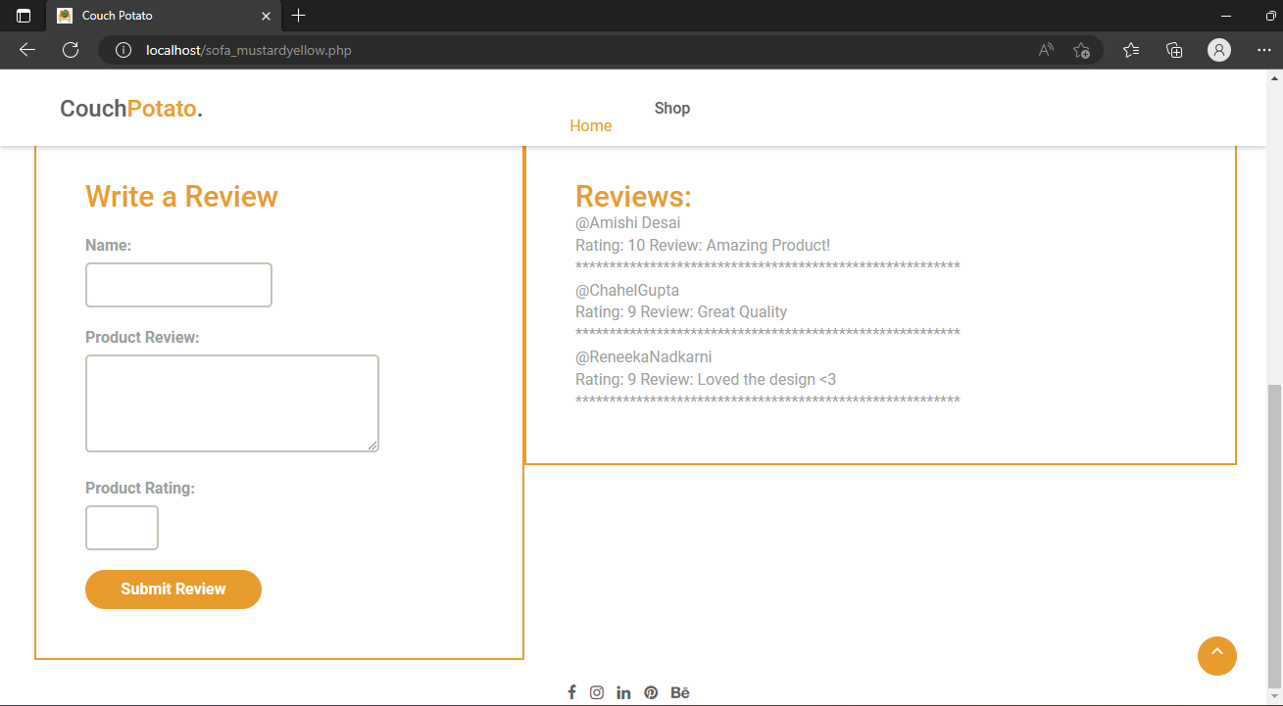
FEEDBACK SYSTEM
CUSTOMER REVIEWS & RATINGS

Slide 25

NOTING EVERY DETAIL
SWOT ANALYSIS
Following one semester of development, we believe we have done our best to create a fully functional website. There are certain advantages, risks, opportunities, and weaknesses with our website.

Slide 26




THANK YOU

